Slide 1

CIC Scorecard Refresh for SIL
Presented by:
Data Science
March 2025

Slide 2
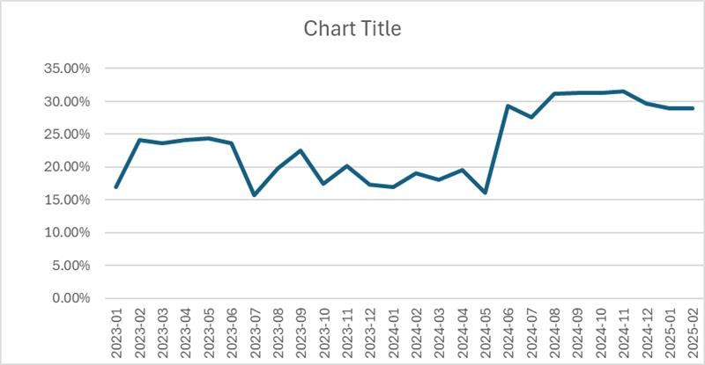
CIC incoming population changed after Crif changed their matching logic from June 2024, so we Refreshed the SIL CIC model from June – September 2024 data
Better quality users (with at least one granted contract but zero non granted contract ever) population has increased from June 2024 onwards.
 | Loan Disbursement Date | # SIL Loans |  |  | # Bad (FSPD30) SIL Loans |  |  | FSPD30 rate
 |  | Overall | Mobile | Non Mobile | Overall | Mobile | Non Mobile | Overall | Mobile | Non Mobile
All Data Training – 90%,val – 10% | 01/06/2024 - 30/09/2024 | 39941 | 14777 | 25164 | 5429 | 2747 | 2682 | 0.1359 | 0.1858 | 0.1065
Oct (Test) | 01/10/2024 - 31/10/2024 | 10707 | 3866 | 6841 | 1418 | 721 | 697 | 0.1324 | 0.1864 | 0.1018
Nov (OOT Test) | 01/11/2024 - 25/11/2024 | 7348 | 1923 | 5425 | 792 | 288 | 504 | 0.1077 | 0.1077 | 0.0929

Slide 3
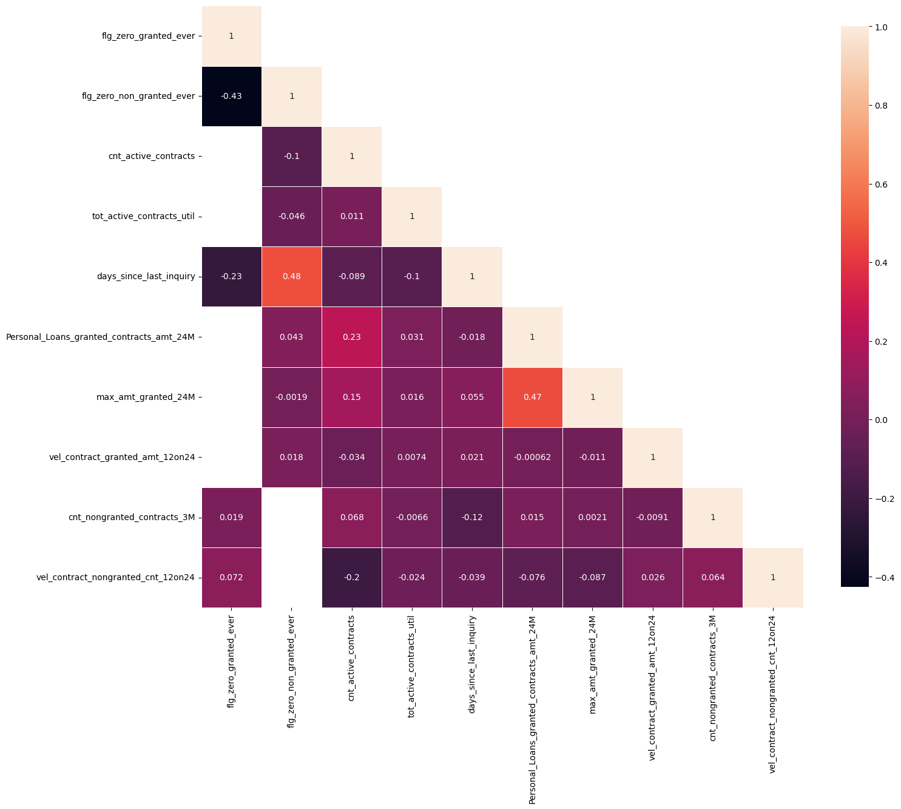
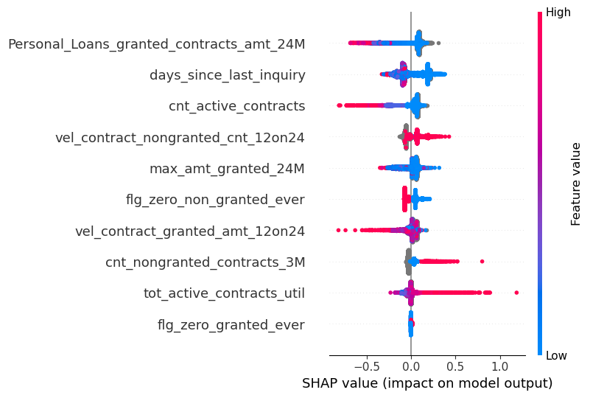
Shortlisted Features and their inter-correlations

Slide 4
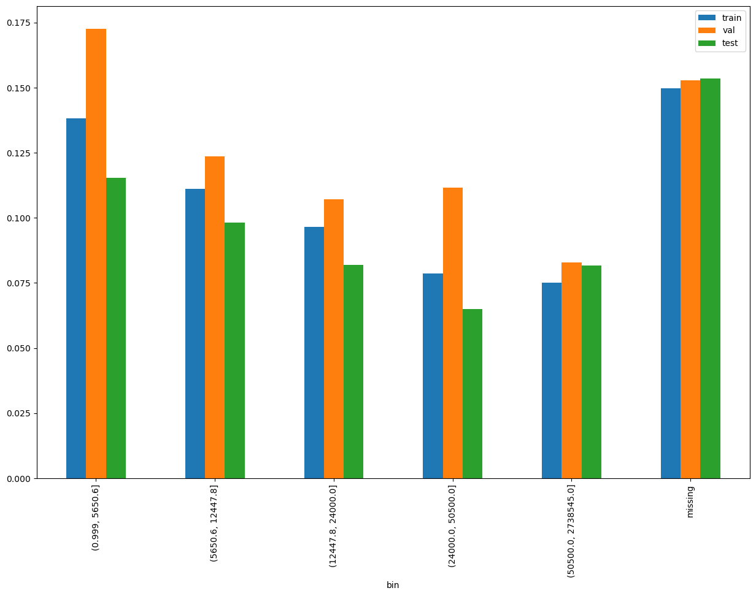
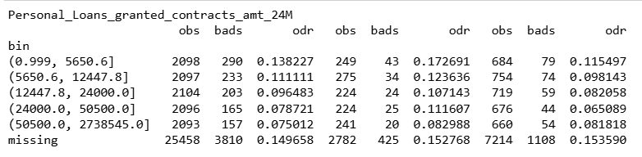
Personal_Loans_granted_contracts_amt_24M
Personal Loans can have high missing values since this is only one type of loan

Slide 5
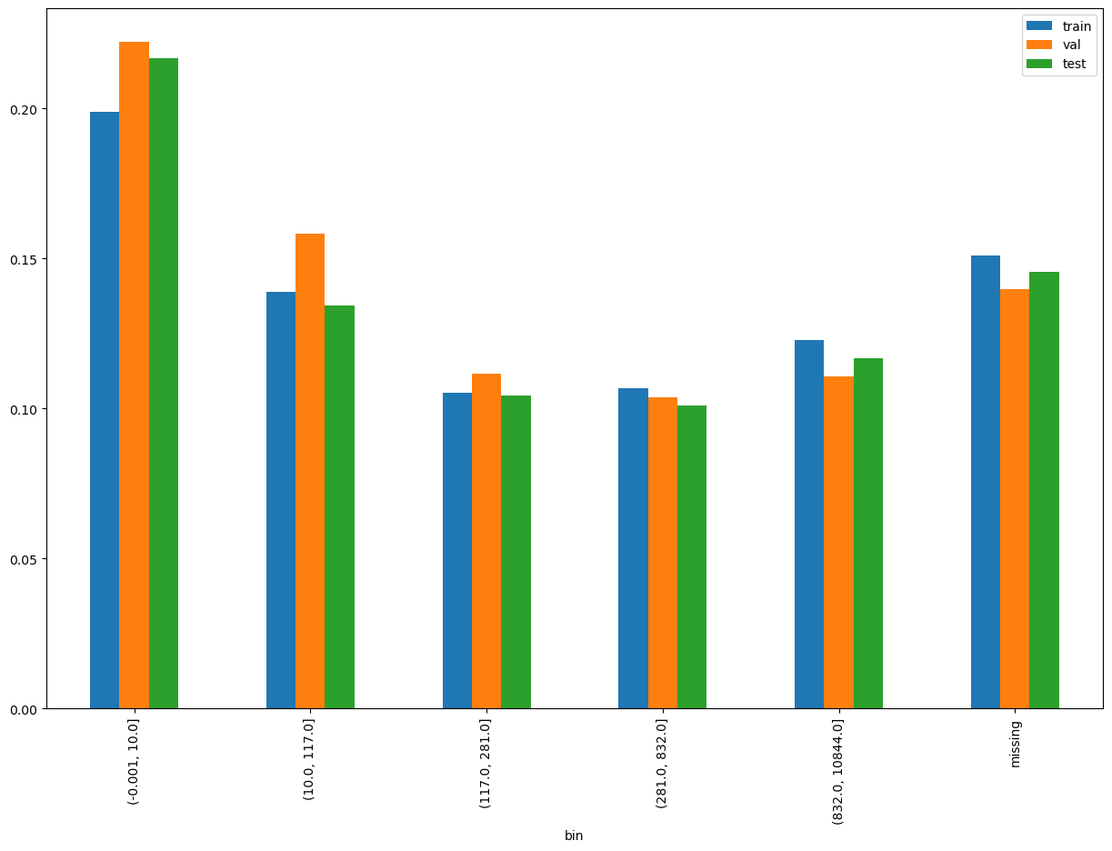
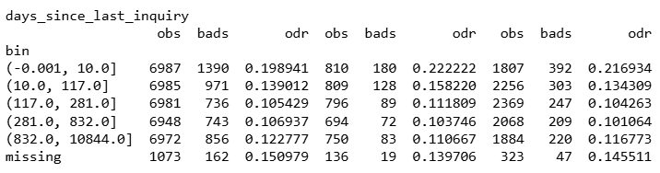
days_since_last_inquiry

Slide 6
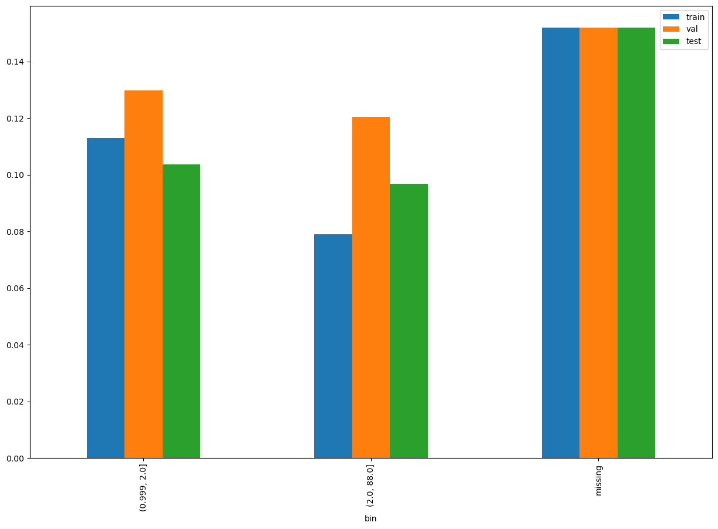
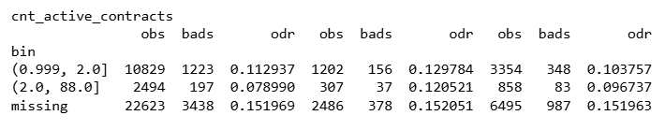
cnt_active_contracts

Slide 7
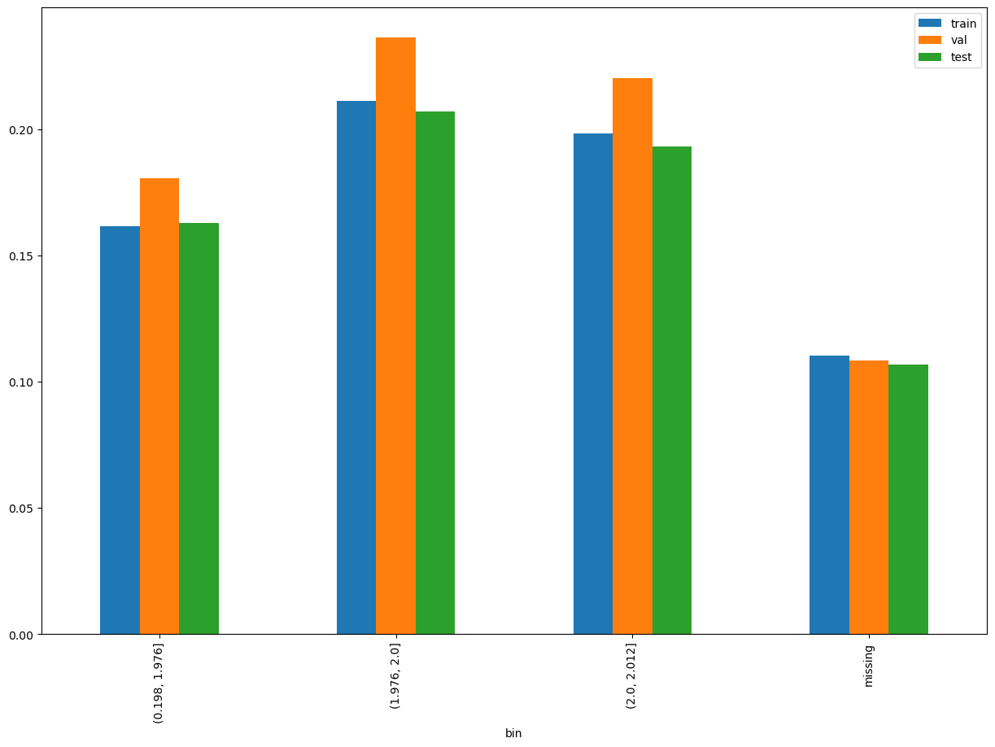
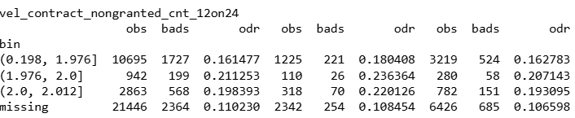
vel_contract_nongranted_cnt_12on24

Slide 8
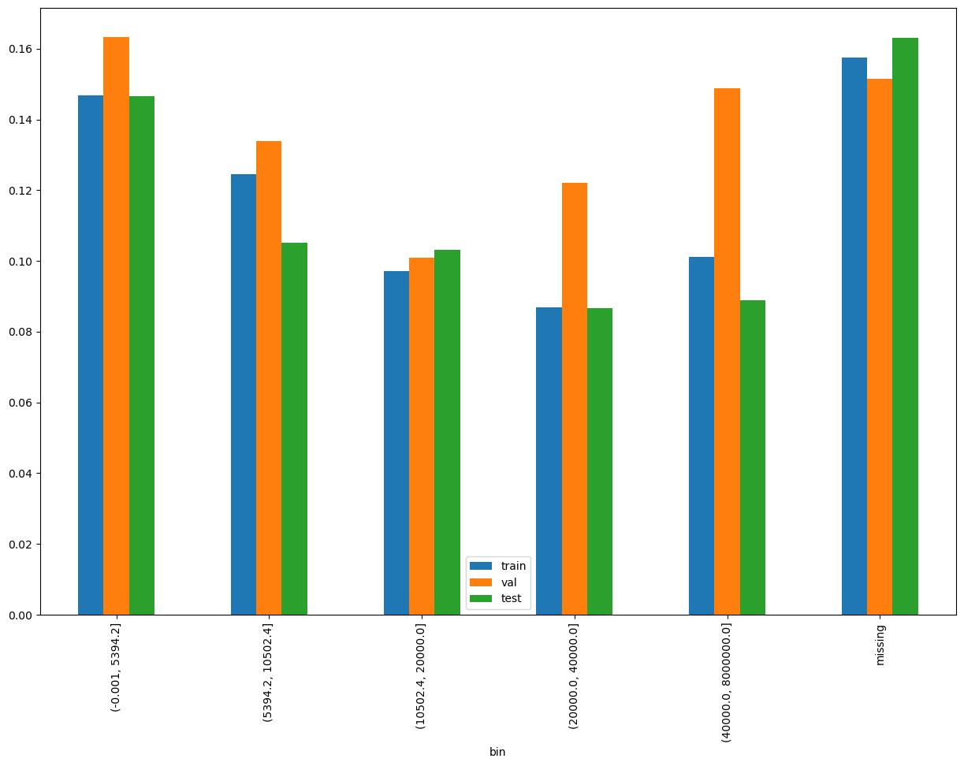
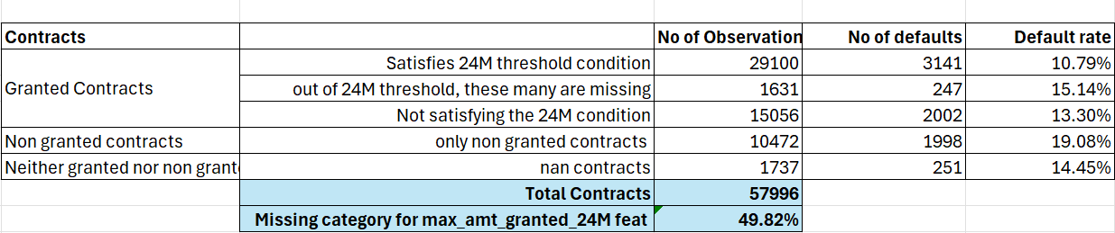
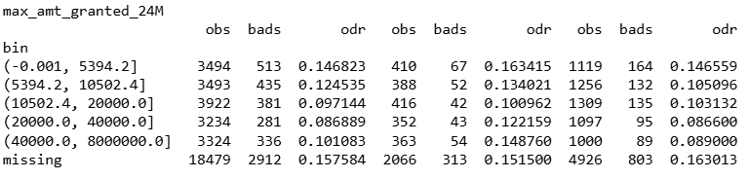
max_amt_granted_24M

Slide 9
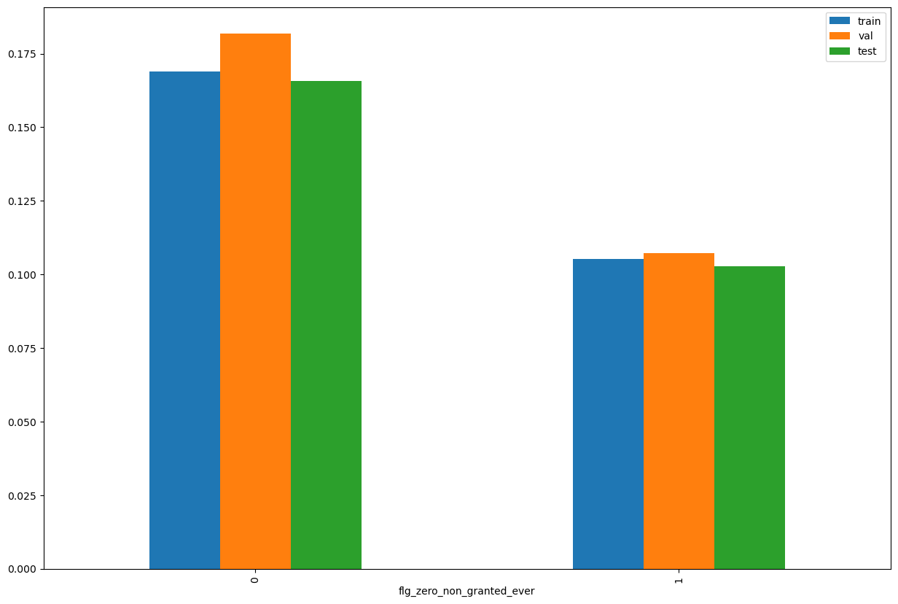
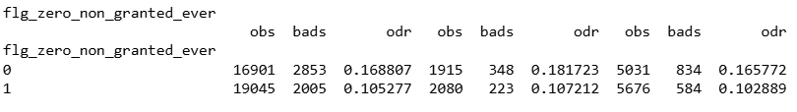
flg_zero_non_granted_ever

Slide 10
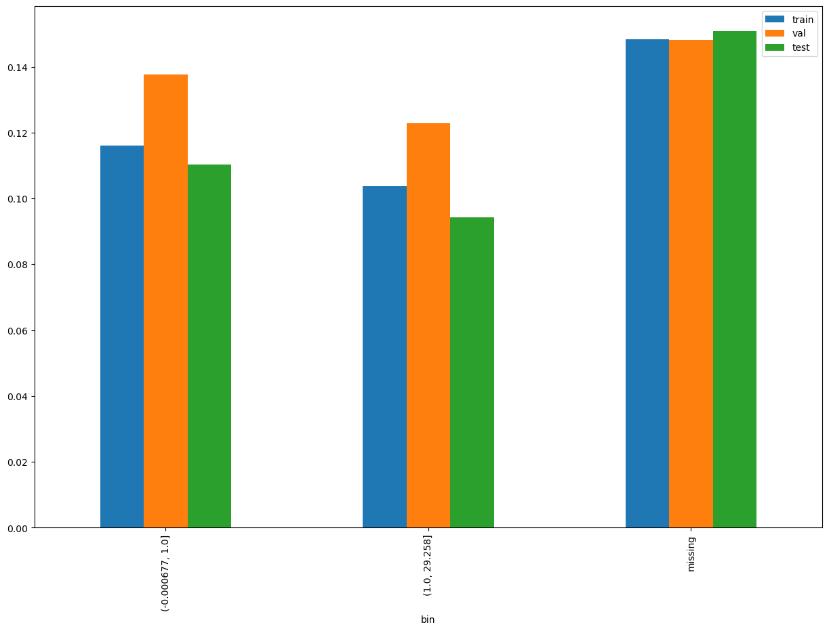
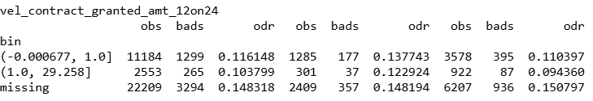
vel_contract_granted_amt_12on24

Slide 11
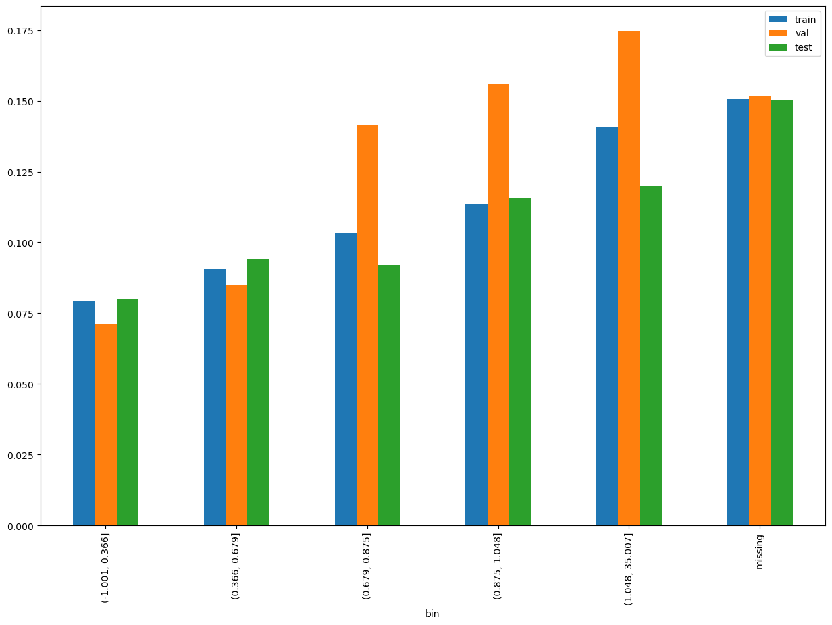
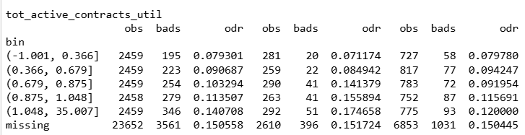
tot_active_contracts_util

Slide 12
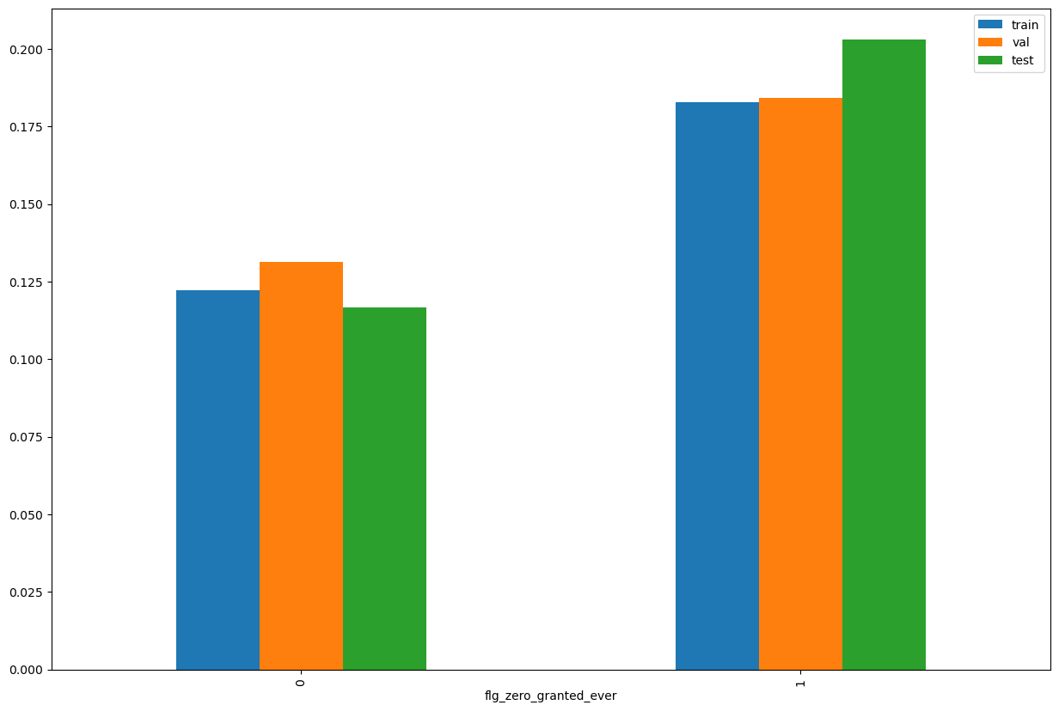
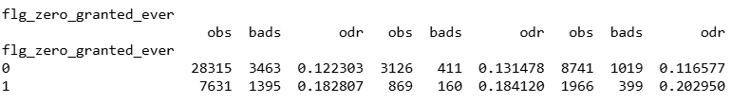
flg_zero_granted_ever

Slide 13
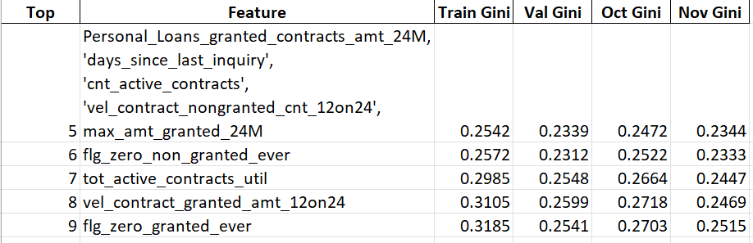
Incremental Gini shows 9 feature model achieves the best performance; hence we have finalized this 9 features model for calculating PSI and Alpha Stack in next pages

Slide 14
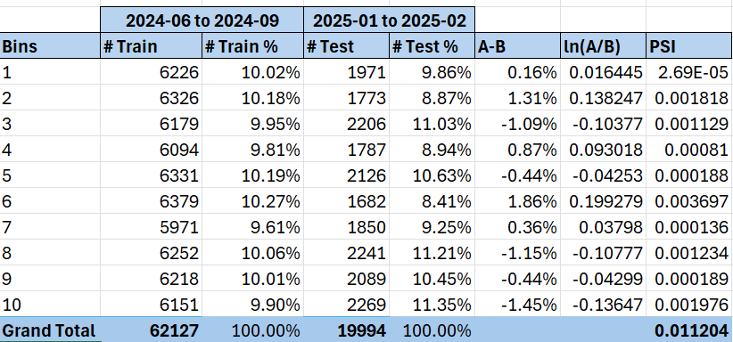
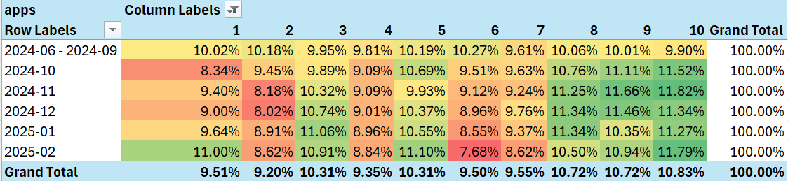
Model PSI and distribution of the population across the months

Slide 15
Alpha Stack Score for Android users
Alpha stacking - Android | 01/06/2024 - 30/09/2024 |  | 01/10/2024 - 31/10/2024 | 01/11/2024 - 25/11/2024
 | Train Gini (90%) | Val Gini (10%) | Oct Gini | Nov Gini
Demo + Credo + CIC | 0.4144 | 0.3895 | 0.3792 | 0.3627
Demo + Apps + CIC | 0.4298 | 0.4119 | 0.3523 | 0.3746
Demo + Apps + Credo + CIC | 0.4468 | 0.4226 | 0.3787 | 0.3831
Alpha stacking - Android | 01/07/2023 - 30/09/2024 |  | 01/10/2024 - 31/10/2024 | 01/11/2024 - 25/11/2024
 | Train Gini (90%) | Val Gini (10%) | Oct Gini | Nov Gini
Demo + Credo + CIC | 0.4260 | 0.3925 | 0.3814 | 0.3633
Demo + Apps + CIC | 0.4555 | 0.4442 | 0.3822 | 0.3744
Demo + Apps + Credo + CIC | 0.4692 | 0.4444 | 0.3967 | 0.3836

Slide 16
Alpha Stack Score for iOS users
Alpha stacking - ios | 01/06/2024 - 30/09/2024 |  | 01/10/2024 - 31/10/2024 | 01/11/2024 - 25/11/2024
 | Train Gini (90%) | Val Gini (10%) | Oct Gini | Nov Gini
Demo + CIC | 0.4436 | 0.2426 | 0.2651 | 0.2065
Demo + Credo + CIC | 0.4897 | 0.2441 | 0.2661 | 0.2004
Alpha stacking - ios | 01/07/2023 - 30/09/2024 |  | 01/10/2024 - 31/10/2024 | 01/11/2024 - 25/11/2024
 | Train Gini (90%) | Val Gini (10%) | Oct Gini | Nov Gini
Demo + CIC | 0.3523 | 0.2595 | 0.2396 | 0.2108
Demo + Credo + CIC | 0.3925 | 0.2853 | 0.2436 | 0.2102

Slide 17
APPENDIX

Slide 18
Approach 2: Training Period April – Sept 2024
 | Loan Disbursement Date | # SIL Loans |  |  | # Bad (FSPD30) SIL Loans |  |  | FSPD30 rate
 |  | Overall | Mobile | Non Mobile | Overall | Mobile | Non Mobile | Overall | Mobile | Non Mobile
All Data Training – 90%,val – 10% | 01/04/2024 - 30/09/2024 | 48802 | 16529 | 32273 | 6467 | 3068 | 3399 | 0.1325 | 0.1856 | 0.1053
Oct | 01/10/2024 - 31/10/2024 | 10707 | 3866 | 6841 | 1418 | 721 | 697 | 0.1324 | 0.1864 | 0.1018
Nov | 01/11/2024 - 25/11/2024 | 7348 | 1923 | 5425 | 792 | 288 | 504 | 0.1077 | 0.1497 | 0.0929

Slide 19
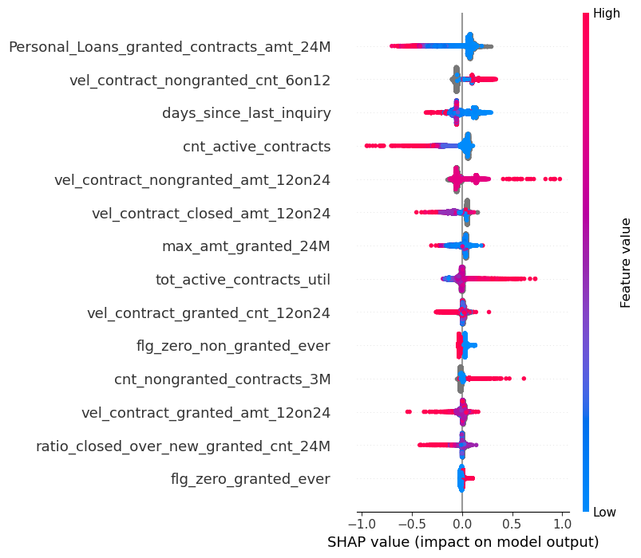
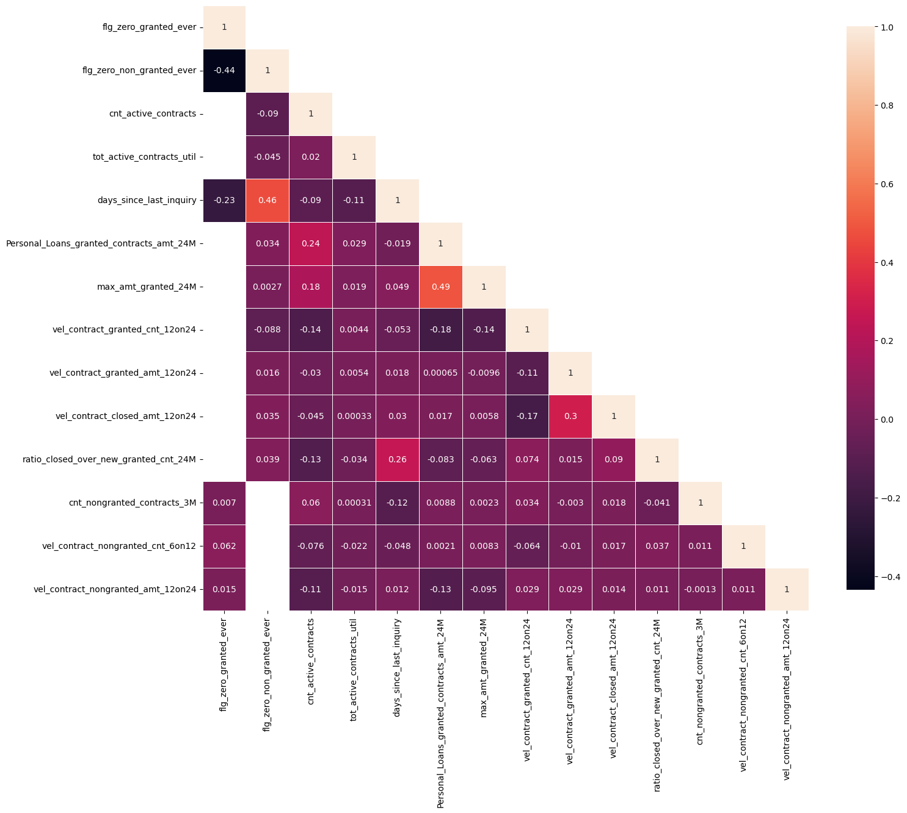
Approach 2 Model Performance

Slide 20
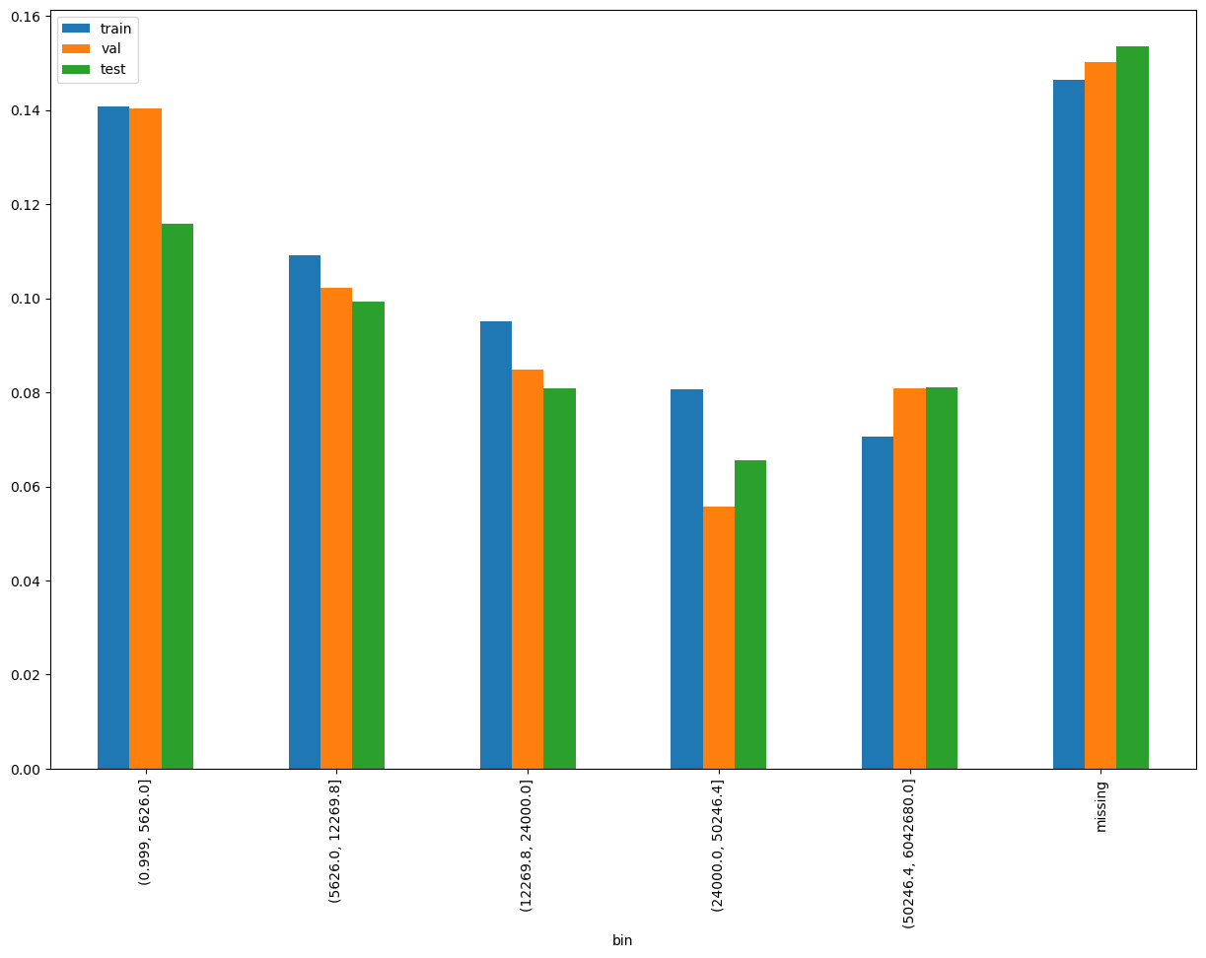
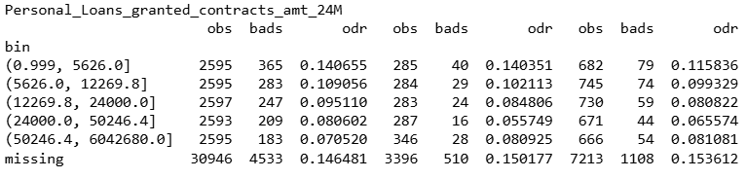
Personal_Loans_granted_contracts_amt_24M

Slide 21
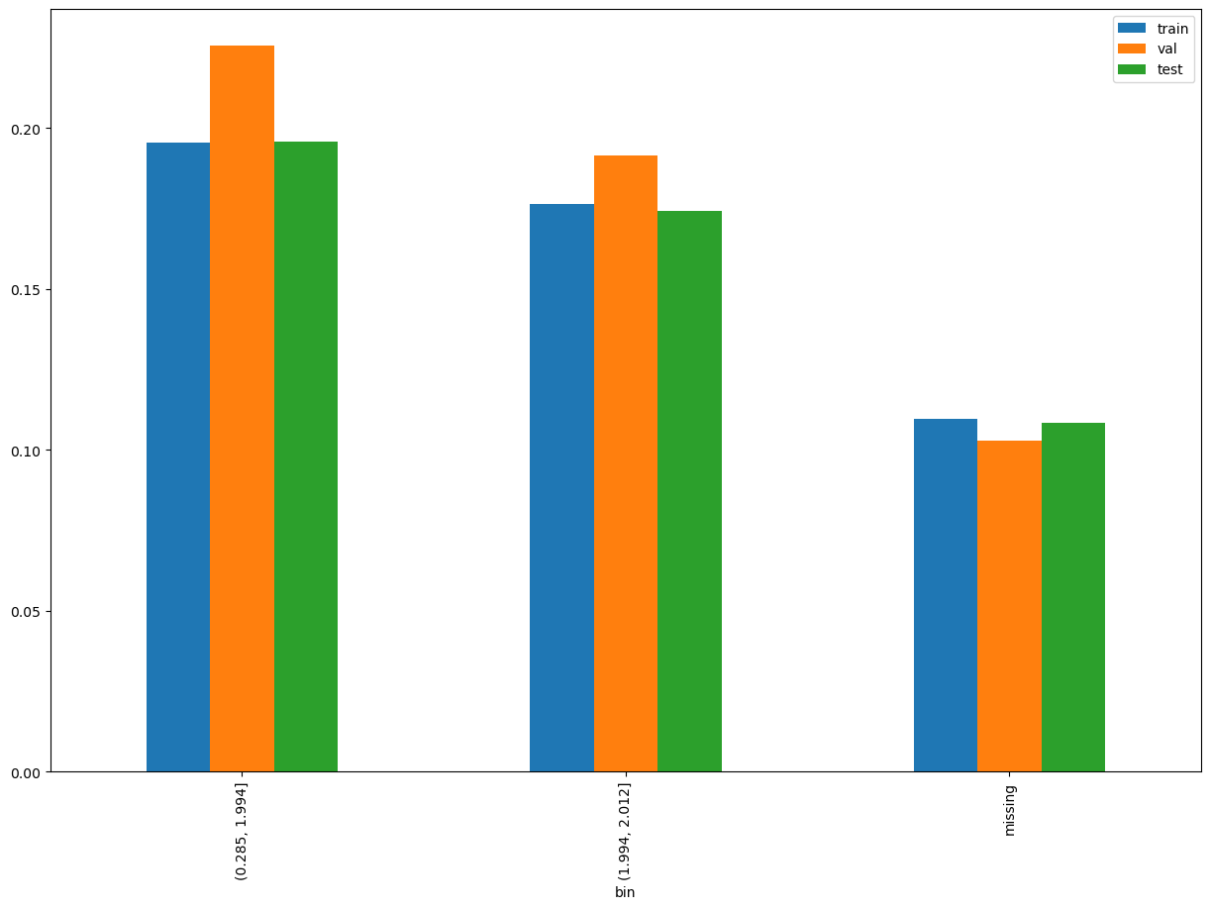
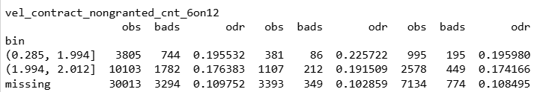
vel_contract_nongranted_cnt_6on12

Slide 22
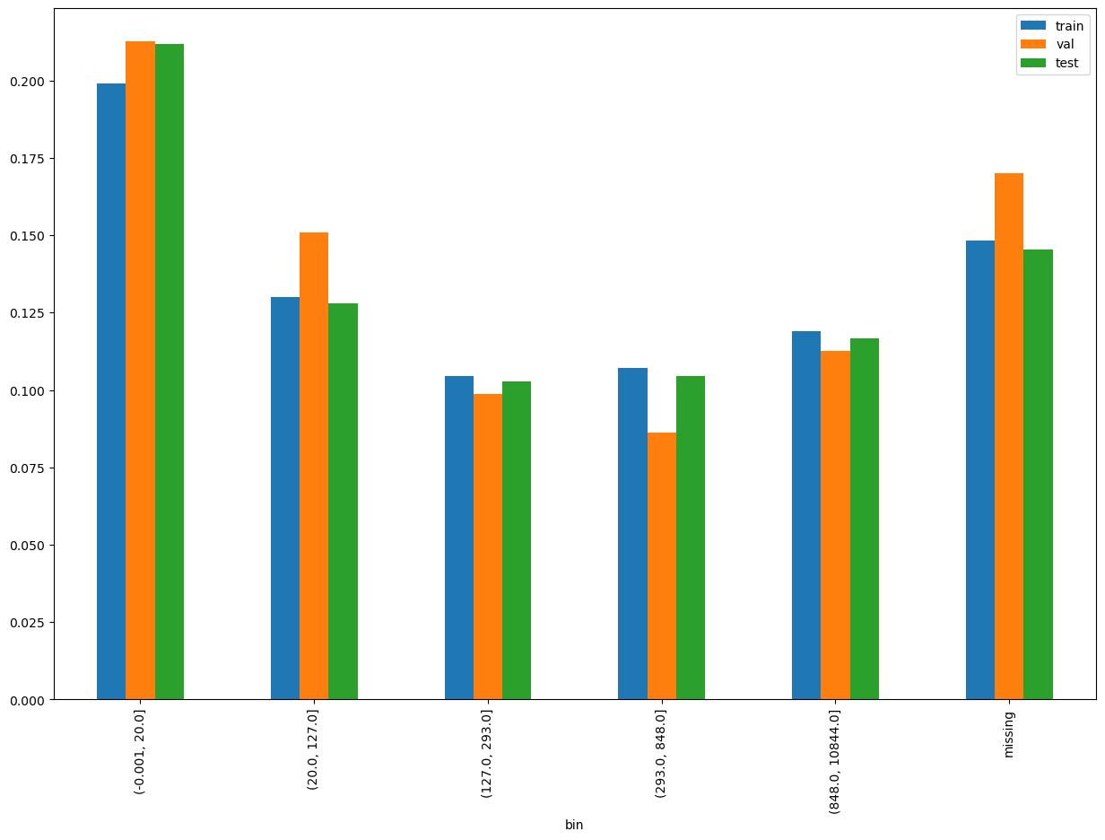
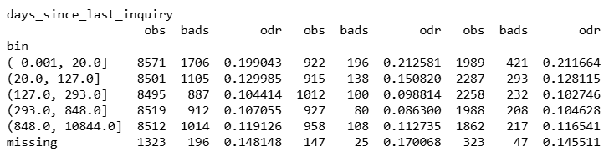
days_since_last_inquiry

Slide 23
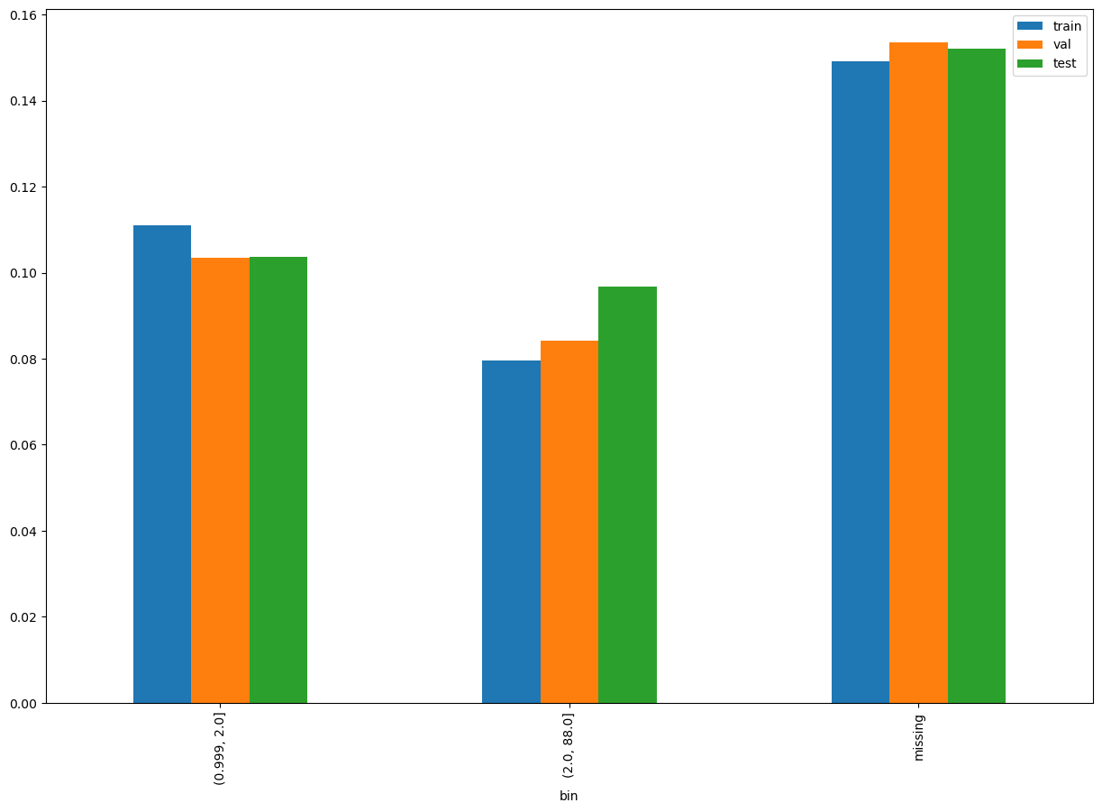
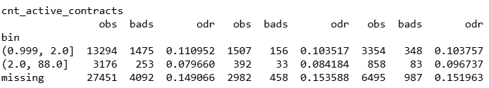
cnt_active_contracts

Slide 24
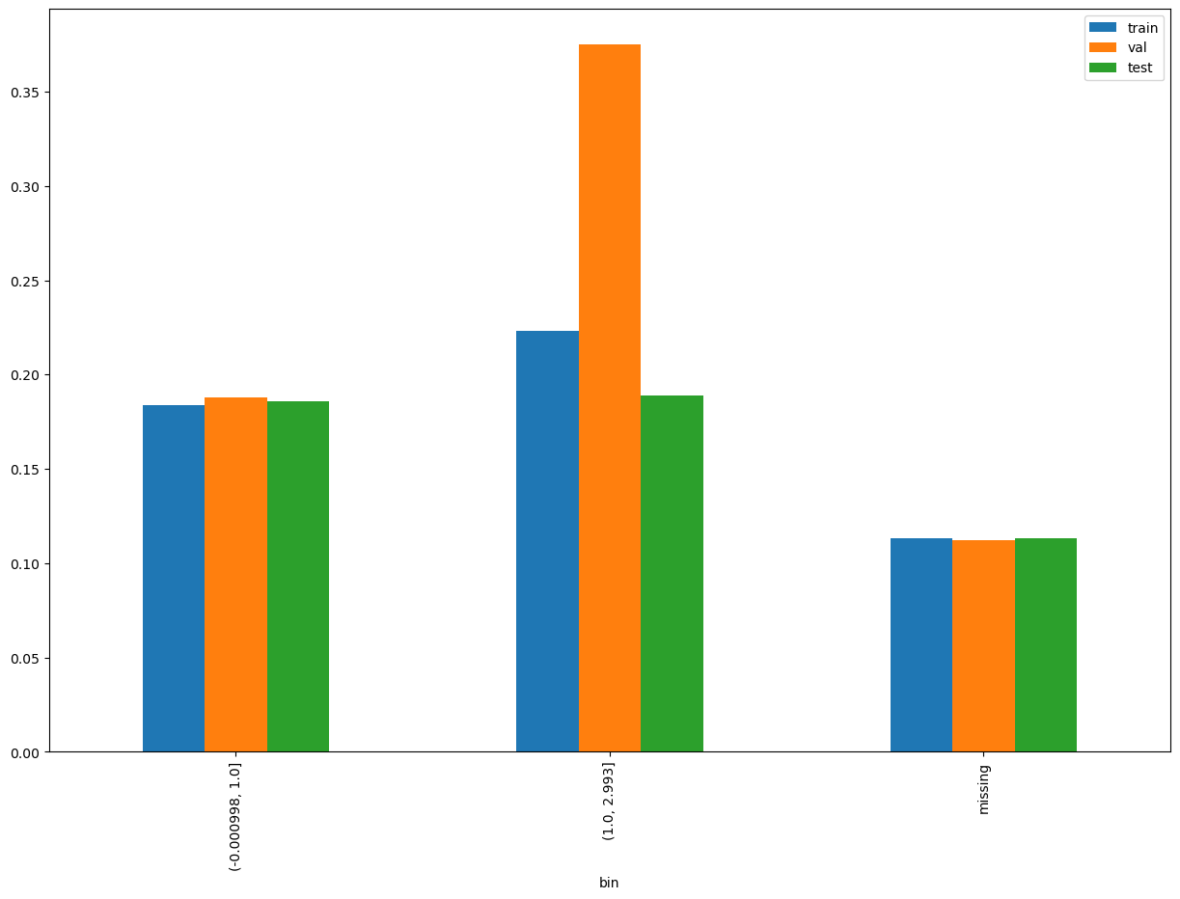
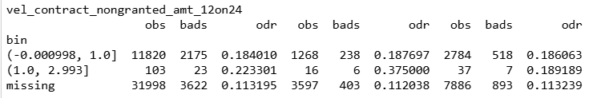
@sowd: pls remove this feature as very small observations for one of the Bins
vel_contract_nongranted_amt_12on24

Slide 25
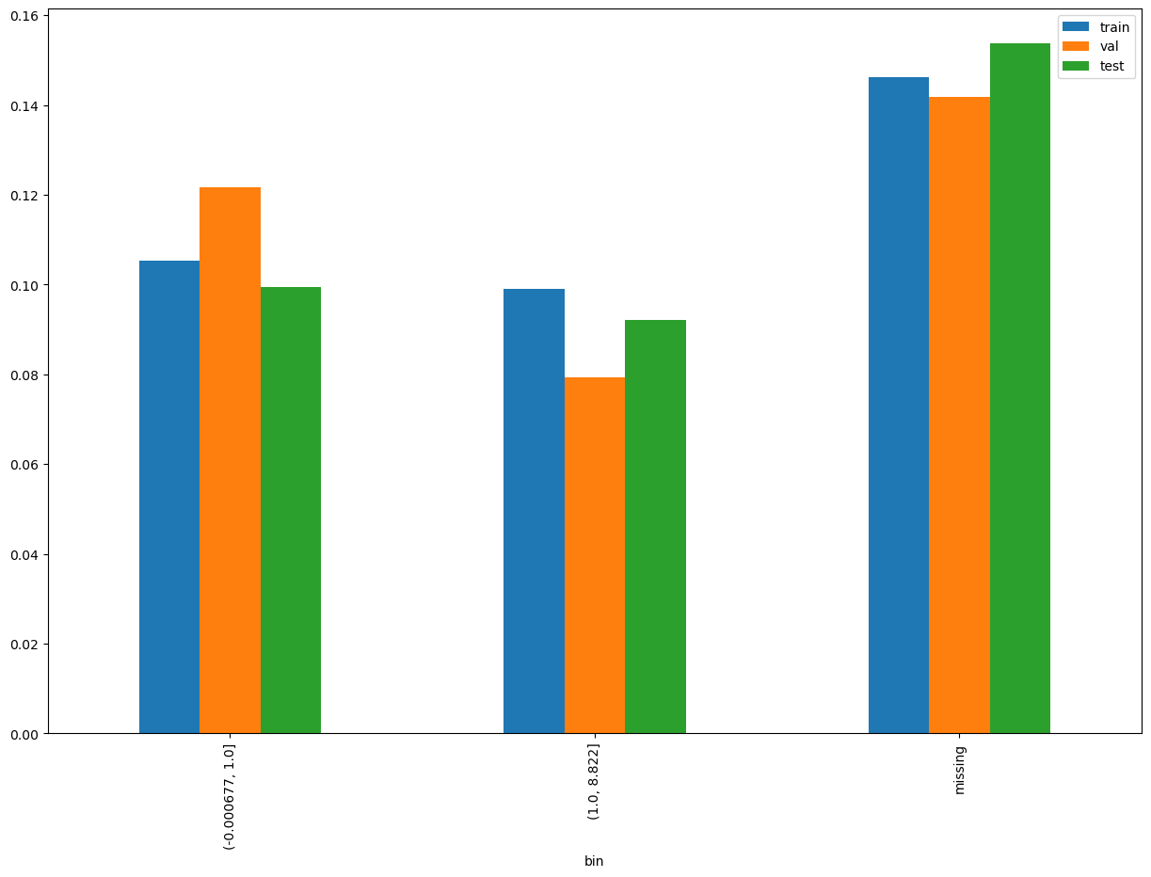
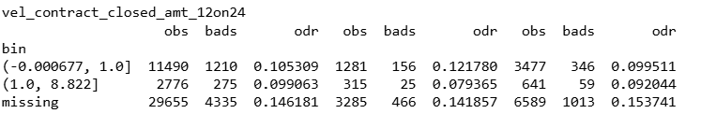
vel_contract_closed_amt_12on24

Slide 26
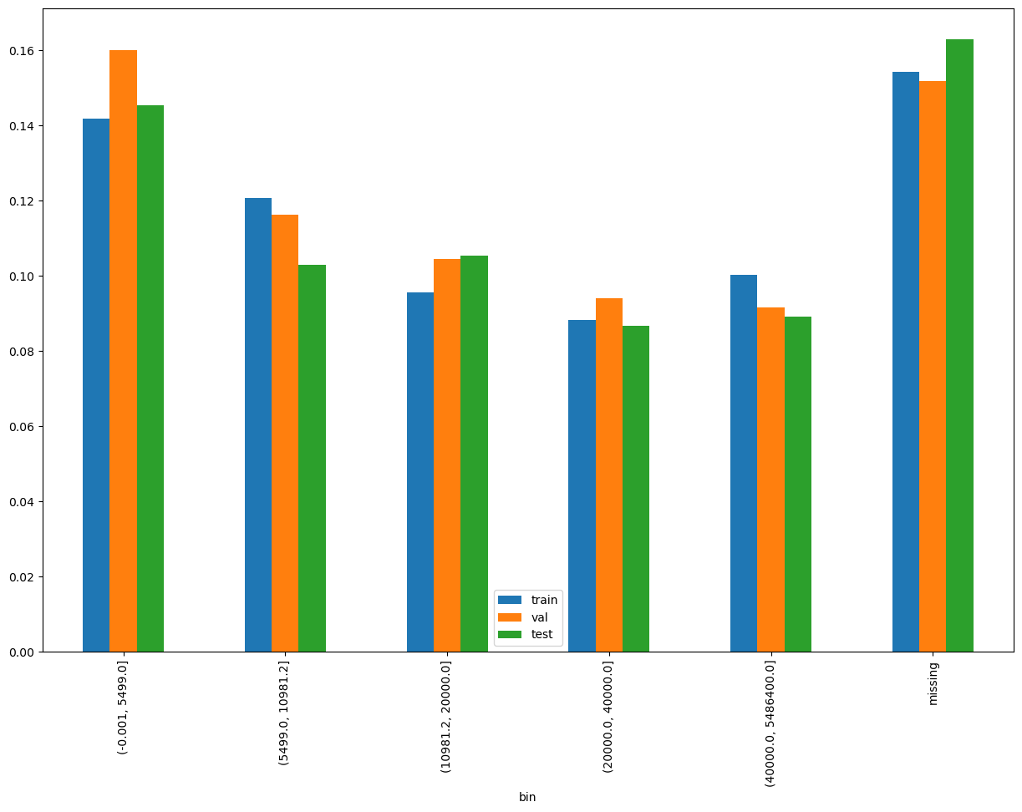
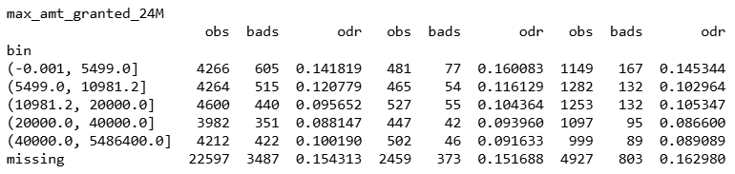
max_amt_granted_24M

Slide 27
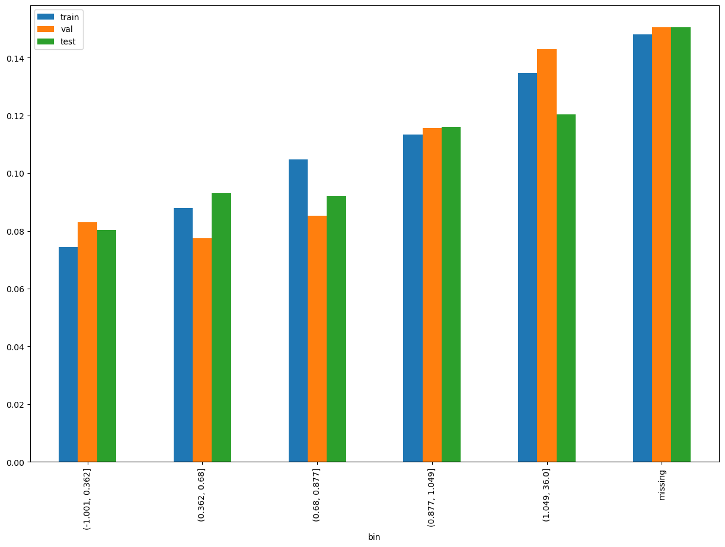
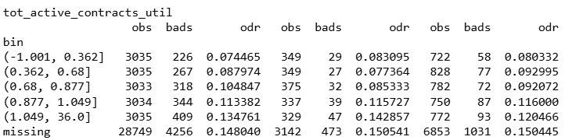
tot_active_contracts_util

Slide 28
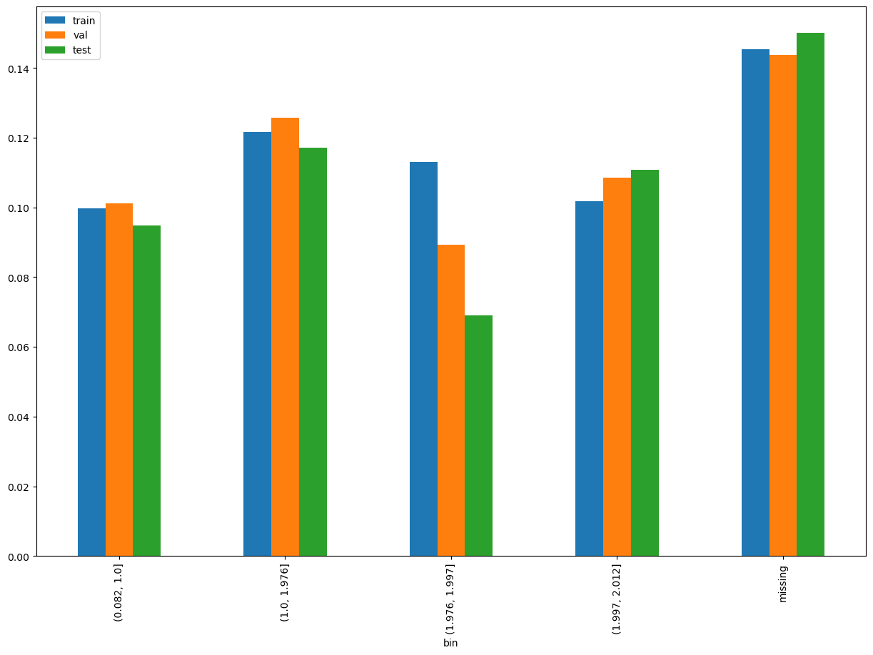
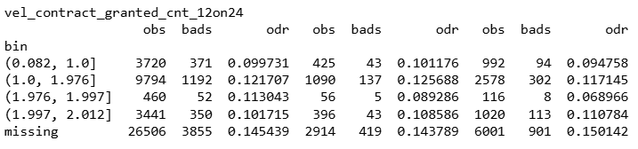
vel_contract_granted_cnt_12on24

Slide 29
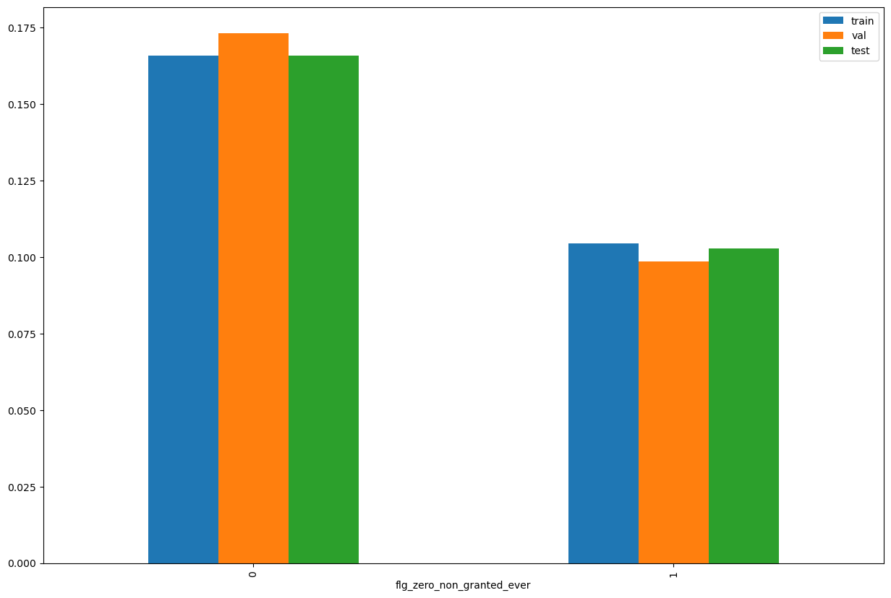
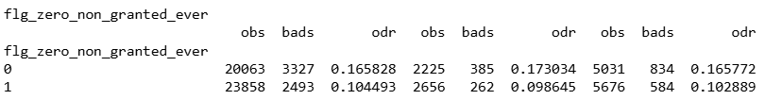
flg_zero_non_granted_ever

Slide 30
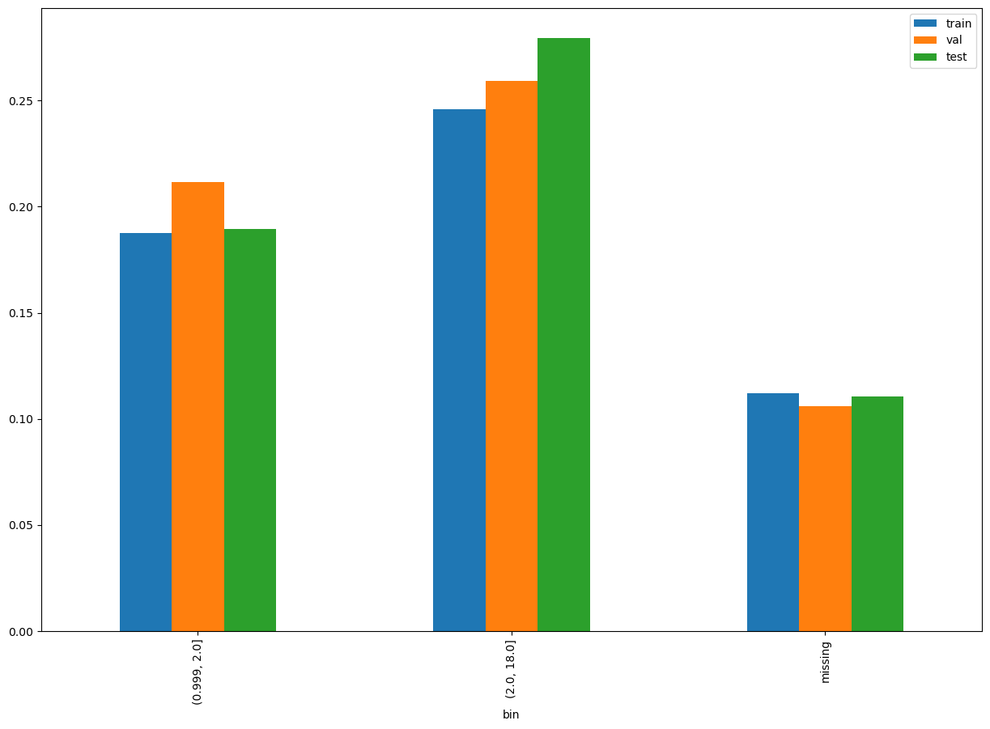
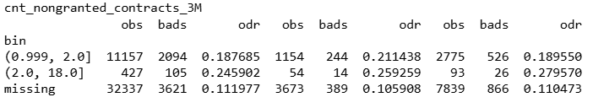
cnt_nongranted_contracts_3M

Slide 31
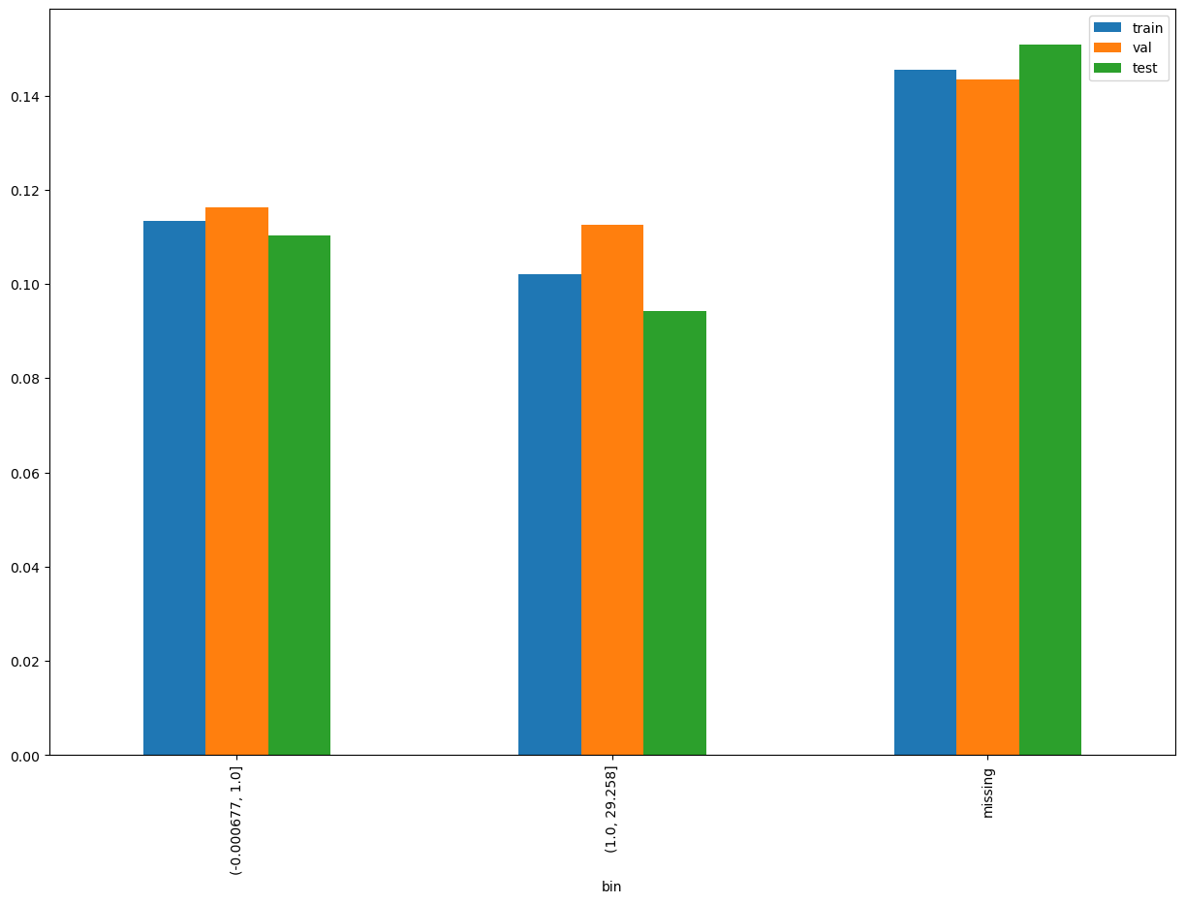

vel_contract_granted_amt_12on24

Slide 32


ratio_closed_over_new_granted_cnt_24M

Slide 33


flg_zero_granted_ever

Slide 34

Incremental Gini

